Slide 1

Ricardo Rendon
Project: Instagram-like app

Slide 2
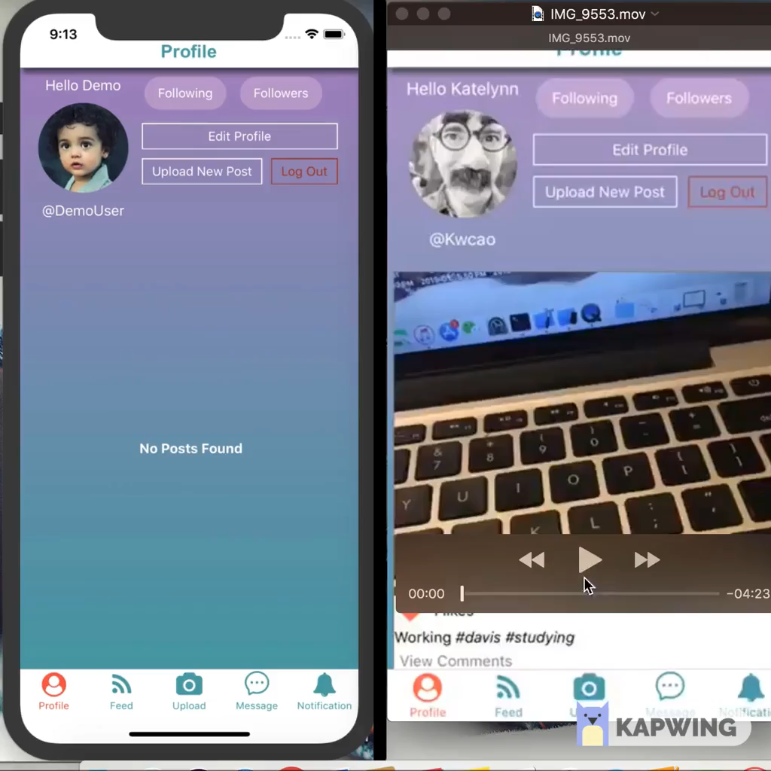
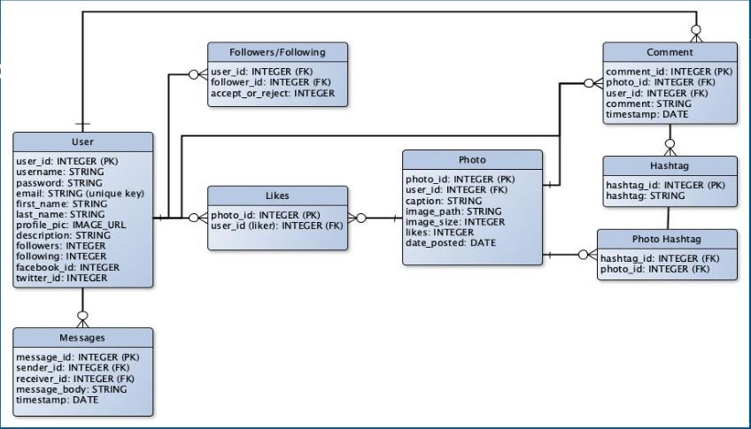
About the project:
Goal:
Create an app that looks like Instagram.
Tools:
JavaScript, React native, firebase.

Slide 3
Once my team and I finished coding the app I was in charged of the analytics.
Performance of the app(KPI):
In addition to coding the app as a group we tried to choose the best metrics to test if the app was doing well once it launched:
This part was very exciting which is the moment I got interested in market analytics.

Slide 4
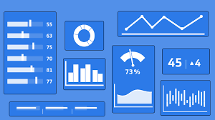

Choosing the best metrics:
What about duration of the session?
But if the app loads slow, what if the internet connection is not the best
What about number of uninstalls?
Useful but why did they uninstall it?
What about numbers of new users?
But what if these only sign up but never use it
Then let's go with active users, but what if these are active but not generating content(posts)
After discussing we decided on:
New unique users, Retention rate, median post per account, session length, daily active users and crashes, app load time
(growth) (type of growth) (stimulating) (something wrong with the code)
Choosing these metrics(combination) will help us understand what was going on with our app:
-Lower retention rate and more crashes, everything else stays the same = check code
-Higher retention rate, lower avrg post per acc, everything else same= growing but not a healthy growth

Slide 5
Disagreements

Slide 6


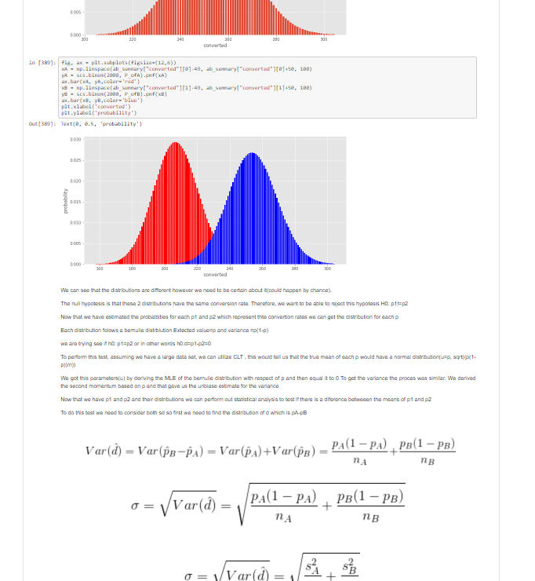
A/B Testing
What happened?
I wanted the main screen to say “Hello” once someone downloaded and opened the app.
My teammates wanted something more formal “Welcome”.
What did I do?
Found a way to solve this situation by using data.
Unfortunately, I did not have the money, time, users or even the completed app to be able to get a sample to run this test.
Let's get ready: code and explanation of the math :
Test if it works: Created two randomized data sets, each one with its respective pre-set conversion rate and prepared the code to be able to run A/B test in find if there is a difference between these two conversion rates.

